Slide 1




OPC UA EPICS Device Support
Interfacing Industrial Controllers
Ralph Lange

Slide 2
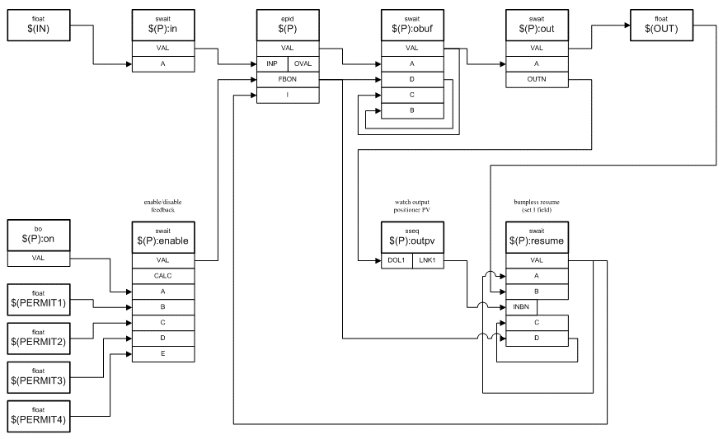
Context: Device Support Connecting Records to Hardware
EPICS clients connect using the pvAccess and Channel Access network protocols
Configurable interconnected objects (records) provide flexibility and functionality
Records that represent I/O channels use the Device Support layer to connect to hardware
EPICS IOC
PVA & CA Network Servers
EPICS Process Database
Device Support Modules

Slide 3

Choices: Standard or Flexibility EPICS Principle: Configuration over Coding
High-level communication standard
Rich standard covers everything you ever need
On-the-wire protocol: standard
Shifts integration effort to the device (vendor)
Low-level communication abstraction with a flexible configuration
Transport of messages is handled by fixed (coded) parts, Content of messages is handled by a configurable engine
On-the-wire protocol: device specific
Shifts integration effort to the IOC (control system engineer)
StreamDevice

Slide 4
Controller Integration Wishlist Also the OPC UA Feature List
Symbolic addressing
names, not numbers
No PLC programming
keep contractors happy
Industrial standard
one to connect them all
Portability
at least Linux, Windows
User-defined structures
for reusable PLC objects
Subscription mechanism
update on change
Server-side queues
handle bursts well
Browsing support
find variables easily
Security (TLS, X.509)
encrypt, sign, authenticate
Remote procedure calls
with parameters and results

Slide 5
The OPC UA Standard Interfacing SCADA to Controllers (PLCs)
Industrial standard (2008) to interface controllers
Covers data, alarms, events, historical data, remote methods
Symbolic addressing
Browsable
Based on OPC Classic (Microsoft, 1996), adding
Portability (does not require DCOM/Windows)
WAN Support (TCP instead of DCOM)
Safety/security (certificate-based authentication and encrypted connection)
Information modeling (user-defined structures)

Slide 6

Why OPC UA? Strategic and Conceptual Arguments
OPC UA is gaining momentum as universal industrial integration standard across vendors and application fields
Open standard, managed by the OPC Foundation, which provides a reference implementation
Vendors can have their products certified by authorized labs, ensuring compliance and compatibility
More and more controllers (e.g., Siemens S7 PLCs, Beckhoff TwinCAT, LabVIEW) offer an embedded OPC UA server

Slide 7
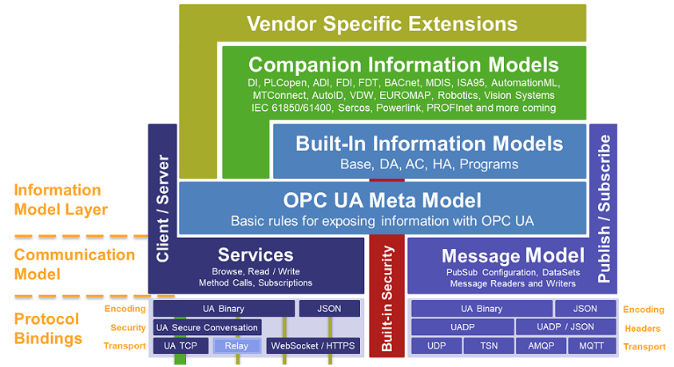
OPC Unified Architecture Overview The Big Picture
Source: Unified Automation

Slide 8
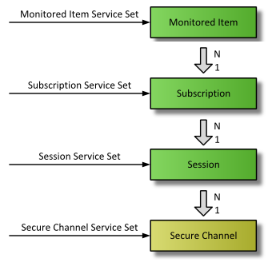
OPC UA Subscription Concept Context Necessary to Subscribe to Data Changes
Monitored Item
One piece of data (simple or structured) that the client is interested in
Subscription
Updates are grouped and sent together
Session
Logical connection
Specific user authN/authZ
Secure Channel
Connection to an OPC UA server
Secured (encrypted and/or signed)
Source: Unified Automation

Slide 9
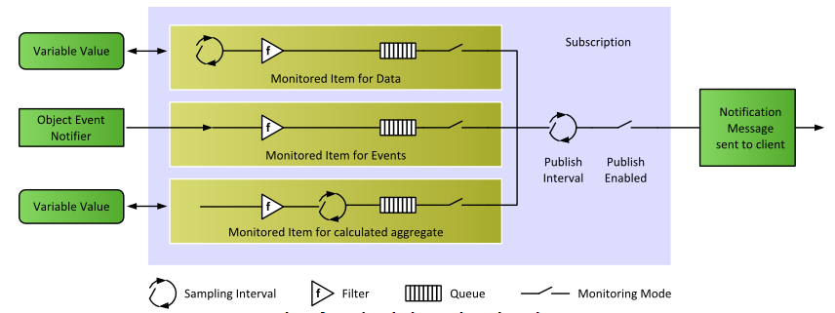
OPC UA Subscription Concept Settings for Subscription and Monitored Items
Source: Unified Automation
Not Supported (Yet)

Slide 10
EPICS Device Support Module Brief History
Evaluation of client library options and Device Support prototype Bernhard Kuner (HZB/BESSY)
ITER use cases tested by F4E (Spain) and TCS (India)
Against S7-1516/1518 embedded OPC UA server
Against WinCC-OA embedded OPC UA server
Current implementation, using a design that allows integrating different low-level client libraries
Recent major contributions from PSI, HZB/BESSY and ESS

Slide 11
EPICS Device Support Module Low-Level OPC UA Client Choices
Stable: Use of commercial C++ Client SDK by Unified Automation
4k€ for source code and 1 year support (extend support: 20% per year) one developer/many products or many developers/one product
Binaries can be deployed/distributed royalty-free
Platforms: Windows and Linux; evaluation bundles available
Newest versions (1.7.9 and 1.8) have issues
New: Use of free open62541 SDK client libraries
Work by Dirk Zimoch (PSI) and Carsten Winkler (HZB/BESSY)
Not trivial to set up
More complexity on the Device Support side
Less documentation than the Unified Automation SDK

Slide 12
EPICS Device Support Module Status
Requirements Specification v1.1: https://bit.ly/opcua-srs-11
Design done (no formal doc)
Implementation nearly complete
All basic data types and arrays thereof (read/write/subscribe)
Supporting all applicable EPICS record types (bidirectional outputs)
User-defined structures (read/write/subscribe), timestamps from data
Server-side queues, configurable connection behavior
OPC UA Security (encrypt, sign, authenticate) Lots of testing help by Roland Fleischhauer (HZB/BESSY)
Integrated end-to-end test against a software server Work by Ross Elliot and Karl Vestin (ESS)

Slide 13
EPICS Device Support Module Roadmap
Started:
Wiki pages: List of servers that have been integrated Useful tricks and hints
Currently:
User Manual (Ralph) ~30% done: integration of current READMEs and Cheat Sheet
Server-side deadband filters (Dirk)
Better enum support (read choices from server) (Dirk)
Soon:
Support for OPC UA methods (remote execution of PLC code) (Ralph)
Support for servers that change structures on-the-fly (Karl)

Slide 14
EPICS Device Support Module Download
Device Support under EPICS license
Upstream repository, Wiki pages, binaries, (future manual): https://github.com/epics-modules/opcua
The GitHub download area has statically linked shared libraries containing the Unified Automation SDK client (i.e., plug-in libraries to link your IOCs against)
Easy to use, fully functional, free forever
Needs to match exactly your Linux distro and EPICS Base
Used in the hands-on part

Slide 15
Users (2022)
Facility | OPC UA Server | Status
ASIPP | LabVIEW | production
 | PLC Siemens S7-1500 | production
Australian Synchrotron | PLC Siemens S7-1500F | near production
BESSY II @HZB | PLC Siemens S7-1500 | production
 | Phoenix Contact | production
 | Softing uaGate | production
CHIMERA @CCFE | PLC Siemens S7-1500 | development
 | LabVIEW | development
ESS | PLC Siemens S7-1500F | production
 | ABB Power SCADA | near production
 | Siemens DESIGO | development
Fermilab | Kepware KEPServerEX | testing
 | PLC Siemens S7-400 | development
IPR | PLC Siemens S7-1500 | testing
ITER | PLC Siemens S7-1500 | production
 | Siemens WinCC OA | production
 | PCVue | production
KATRIN @KIT | LabVIEW | prototyping
PSI | PLC Siemens S7-1500 | development
Varian ProBeam | PLC Siemens S7 | production
 | PLC Beckhoff | production

Slide 16
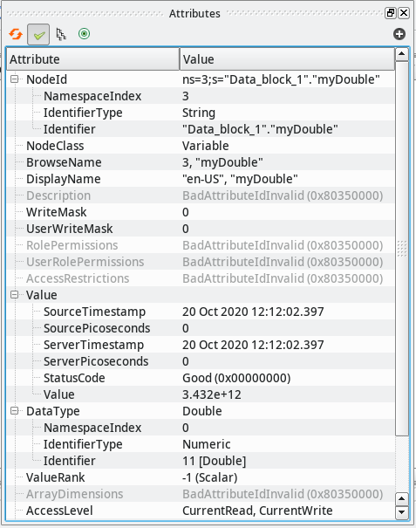
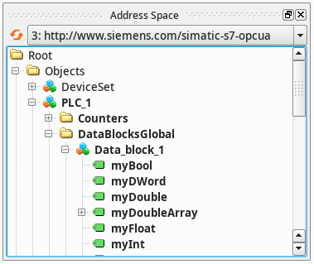
OPC UA Integration Workflow Step 1: Browse the Server
Free browsing tool: UaExpert

Slide 17
OPC UA Integration Workflow Step 2: Configure the IOC
Configure the OPC UA server connections from the startup script
Add an EPICS record to your database
opcuaSession PLC1 opc.tcp://plc1.controls.local:4840 sec-mode=None
opcuaSubscription SUB1 PLC1 200
record(ai, "$(DEVICE):dbl1") {
field(DTYP, "OPCUA")
field(INP, "@SUB1 ns=3;s=\"Data_block_1\".\"myDouble\"")
field(PREC, "3")
}

Slide 18
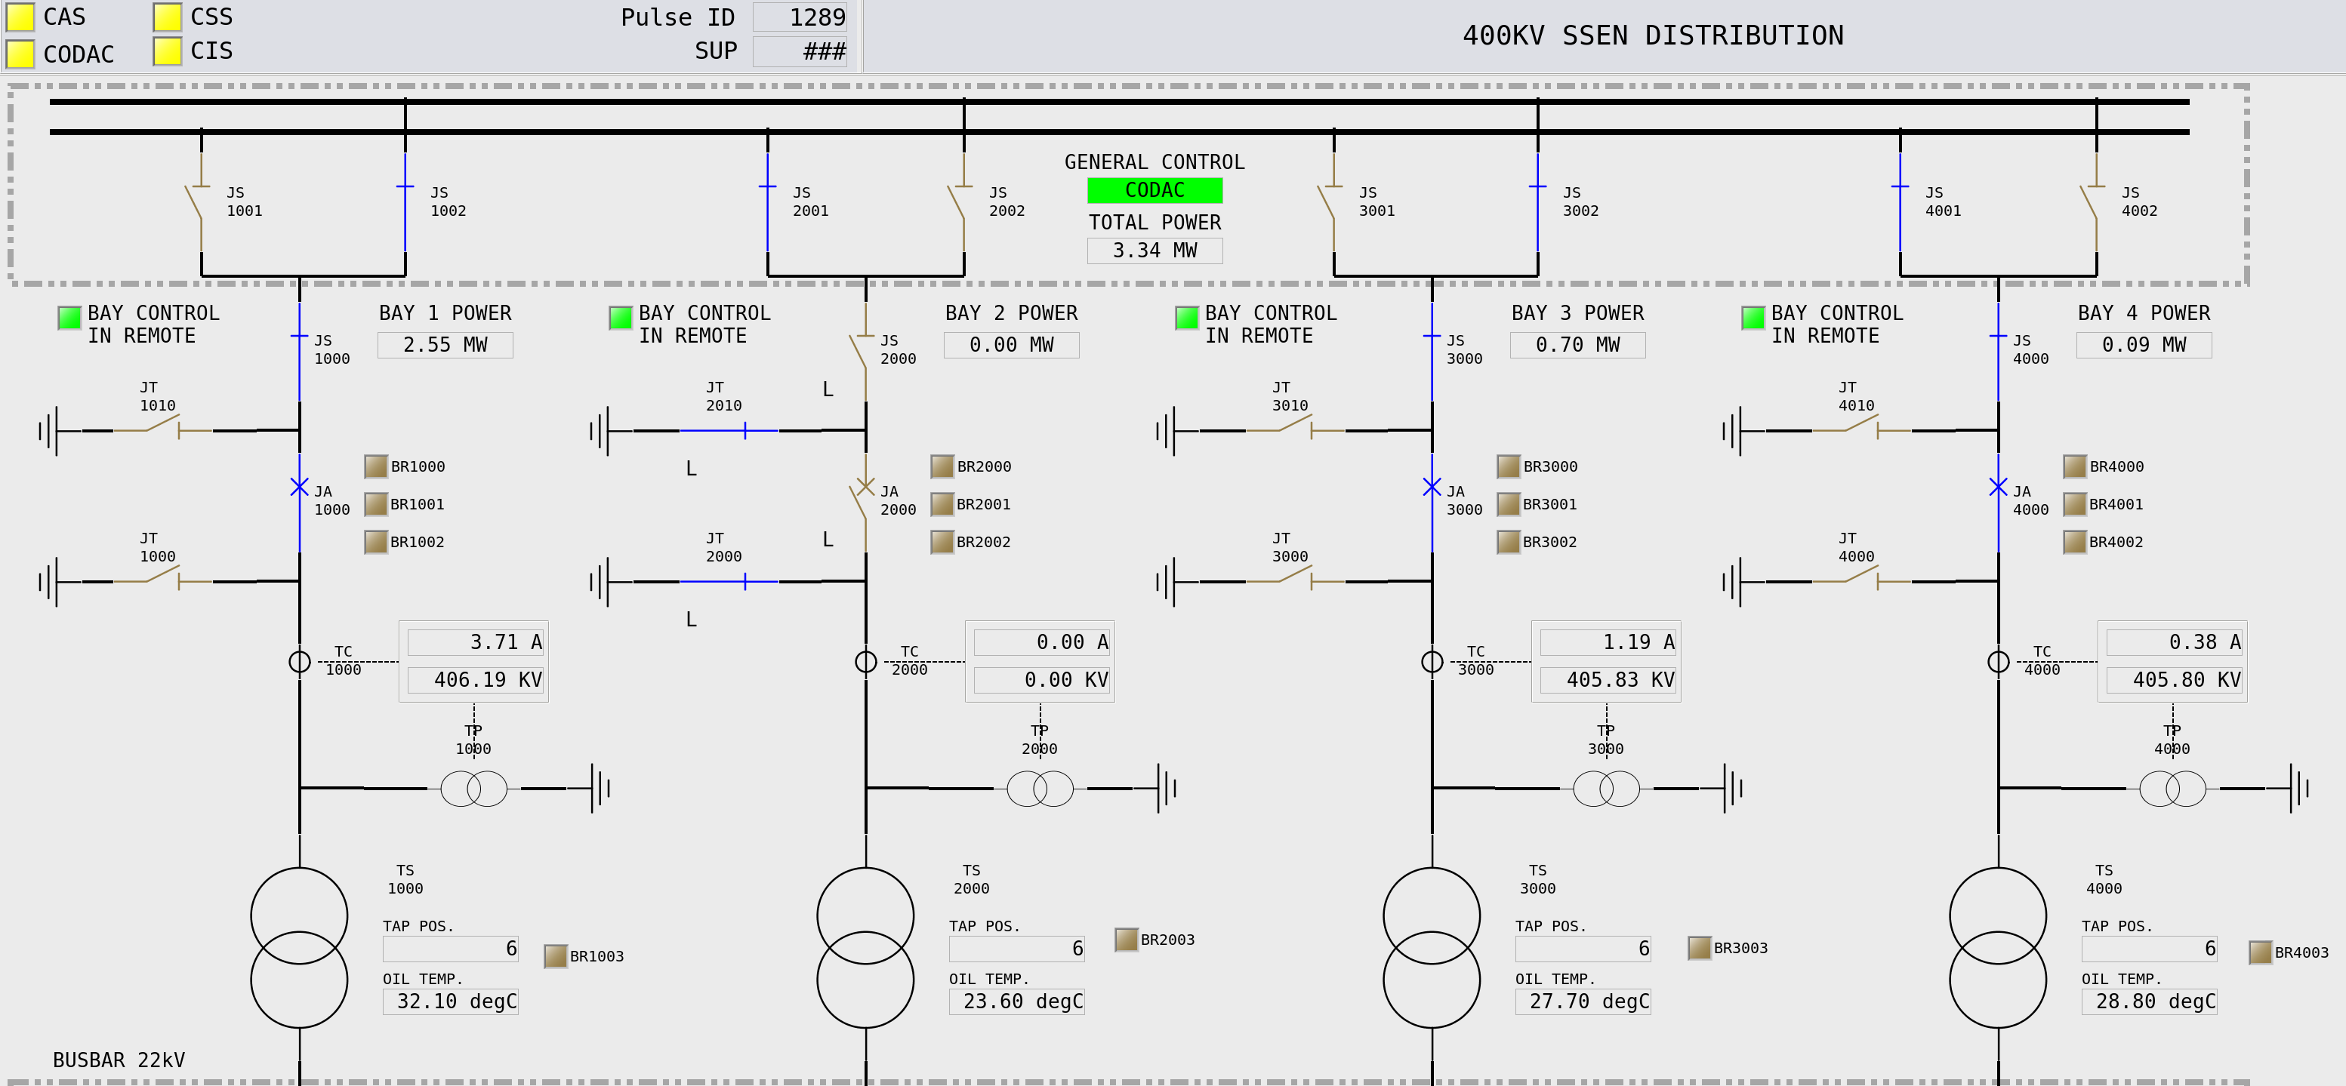
OPC UA Integration Workflow Step 3: Design Your Client Applications and Connect

Slide 19
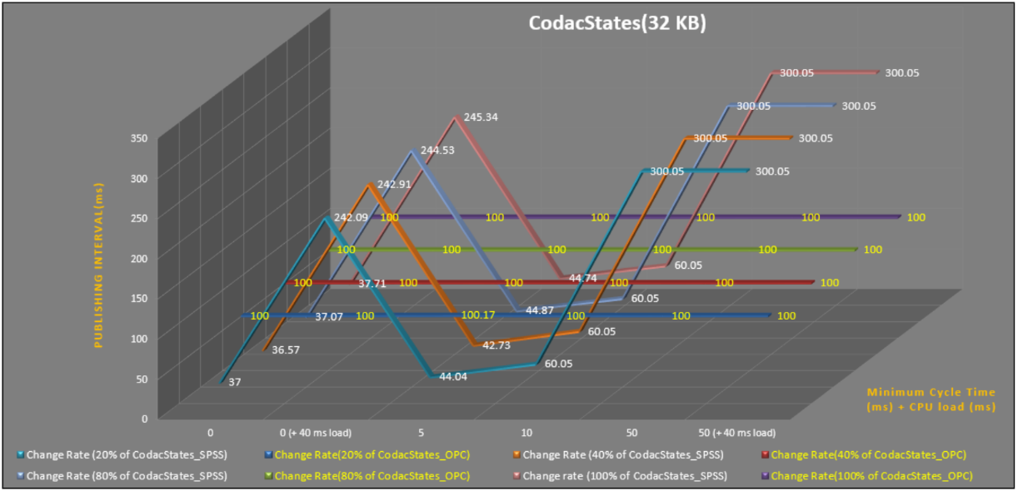
Performance It All Depends – Mostly on the Server
Early tests by TCS, comparing TCP Data Block transfer with OPC UA: “big” S7-1518, 32kB data (integers), “empty” / 40ms cycle artificial load

Slide 20
Performance It All Depends – Mostly on the Server
Test in 2021 for ITER building automation integration
Trying to verify realistic conditions
3x the estimated size (500kB data, mixed types)
On a mid-size S7-1516
250ms sampling/publishing period
No performance fine-tuning
Results:
Fit for this purpose
Best performance when using few large structures

Slide 21
Limitations It All Depends – Mostly on the Server
Limits found on the server end
S7-1500: depends on the model (S/M/L) and data organization
How many, how large, how often?
Client-side fine tuning available e.g., “registering” items to cache server-side name resolution
Servers separate from PLCs introduce additional latency
Found one limit in the client
LabVIEW serving 600 arrays of 7500 doubles each (~36MB data) -> SDK client has a limit of ~16MB for the serializer Solved by splitting to three subscriptions of 200 arrays each

Slide 22
Out-of-Scope
Interesting Ideas

Slide 23
An IOC as an OPC UA Server? Complicated and Hard to Do
This way of operation has not been requested by anyone
EPICS is usually the top SCADA system used for integration
Two exceptions: teams that wanted to use an EPICS IOC as a controller in the context of an industrial control system
The open62541 server could be run on the IOC
In EPICS 7, there is a server API that both CA and PVA servers use
QSRV could work as a model for the Database integration
The big task: getting the information model right
Needs considerable experience with OPC UA server design
The Companion Information Model needs to be done right to assure interoperability

Slide 24
A Generic OPC UA – EPICS Bridge? Even More Complicated and Harder to Do
OPC UA has well-defined, located namespaces EPICS has a single global namespace
Scalability: a single OPC UA server can’t serve a complete facility
Unlike EPICS, OPC UA has the concept of a “device”
OPC UA always needs the server name first CA/PVA only use the PV name, never the server
OPC UA is completely browsable CA is not browsable, PVA only if the server implements it
Companion Information Model would need to cover PVA in a generic way
Can the Normative Types be mapped to standard OPC UA structures?

